Slide 1

WOMEN IN ENTERPRISE AI / OCTOBER 15, 2026
Women in
Enterprise AI
the Signal Room
Personal assistants and working calculators
Session notes and examples
the Signal Room for Women in Enterprise AI
01
Notes:
October 15, 2026. The Signal Room for Women in Enterprise AI discussed personal assistants and enterprise adoption. These materials replace the unused buying-committee demonstration with calculator examples. Discussion is summarized without identifying participants. Amanda Machan of nCino is named only in the upcoming speaker announcement, with host authorization.

Slide 2
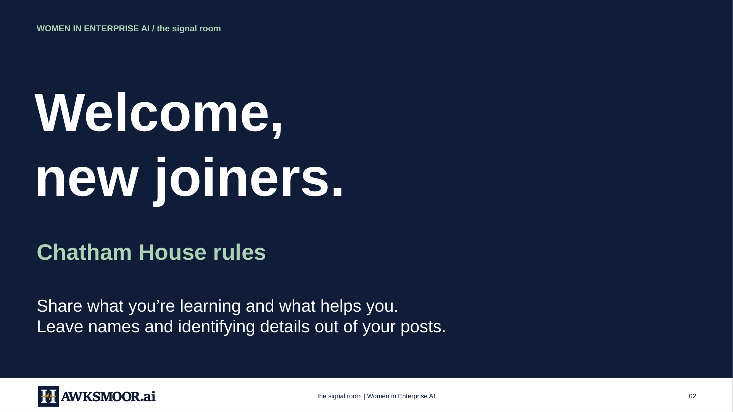
the Signal Room for Women in Enterprise AI
02
Notes:
the signal room | Women in Enterprise AI
02
the signal room | Women in Enterprise AI
02
WOMEN IN ENTERPRISE AI / the signal room
Welcome,
new joiners.
Chatham House rules
Share what you’re learning and what helps you.
Leave names and identifying details out of your posts.

Slide 3
WOMEN IN ENTERPRISE AI / the Signal Room
News and safeguards lead into calculator examples
01
What’s new in AI?
Recent developments and their practical implications
02
Follow-up from last session
Upgrade your existing Chief of Staff
03
Try this
Build working calculators inside ChatGPT
04
Gets
Optional requests for help
05
Future sessions
October 23 and October 30
06
Thank you
Continue the conversation
the Signal Room for Women in Enterprise AI
03
Notes:
The deck retains the news and Chief of Staff update. Calculator examples replace the planned AI build. Gets remain optional. Upcoming sessions are listed before the closing slide.

Slide 4
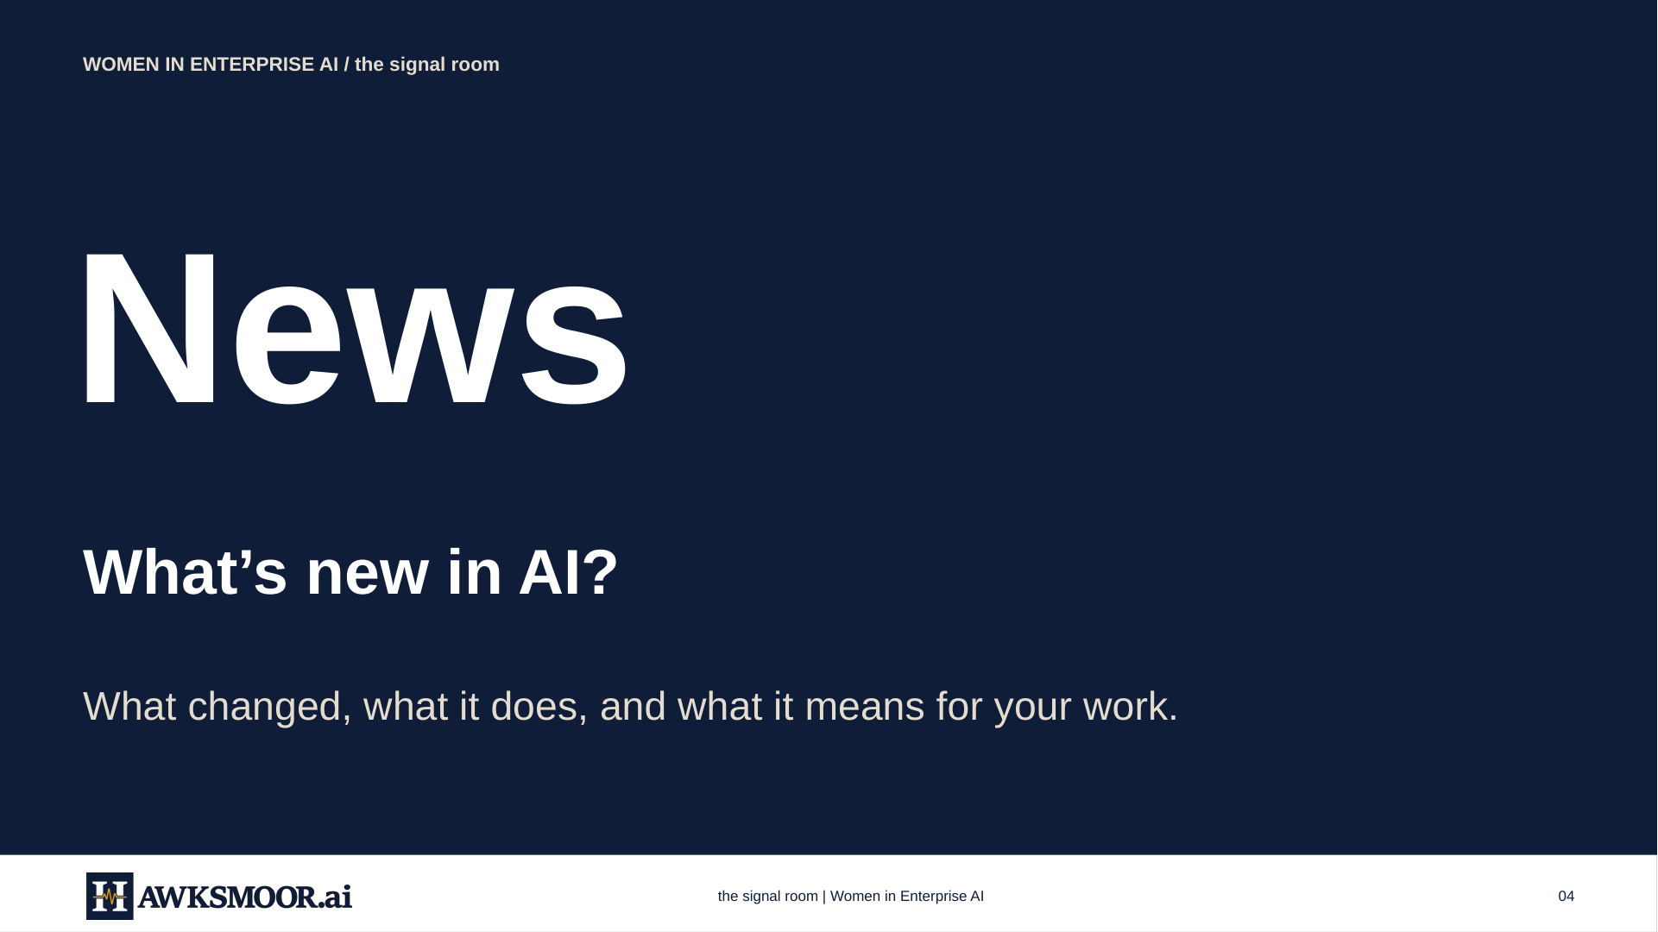
the Signal Room for Women in Enterprise AI
04
Notes:
the signal room | Women in Enterprise AI
04
the signal room | Women in Enterprise AI
04
WOMEN IN ENTERPRISE AI / the signal room
News
What’s new in AI?
What changed, what it does, and what it means for your work.

Slide 5
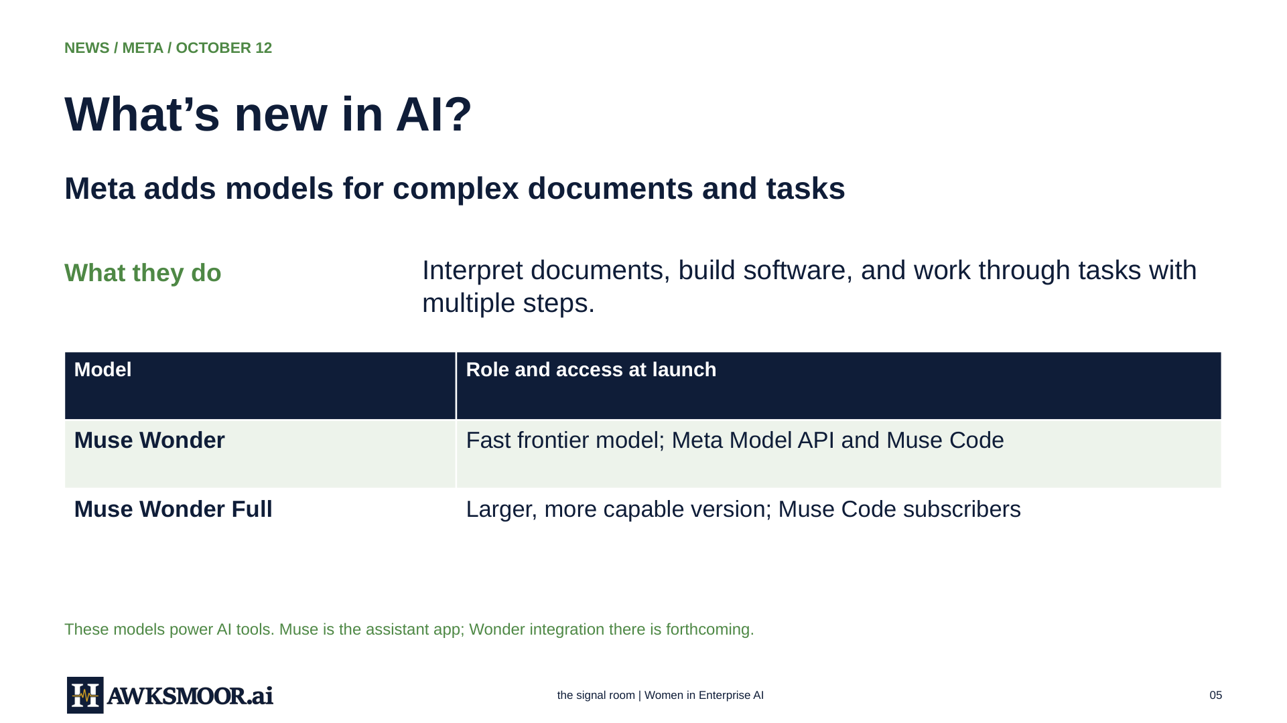
the Signal Room for Women in Enterprise AI
05
Notes:
the signal room | Women in Enterprise AI
05
the signal room | Women in Enterprise AI
05
NEWS / META / OCTOBER 12
What’s new in AI?
Meta adds models for complex documents and tasks
What they do
Interpret documents, build software, and work through tasks with
multiple steps.
Model
Role and access at launch
Muse Wonder
Fast frontier model; Meta Model API and Muse Code
Muse Wonder Full
Larger, more capable version; Muse Code subscribers
These models power AI tools. Muse is the assistant app; Wonder integration there is forthcoming.

Slide 6
NEWS / META / WHAT IT MEANS
What’s new in AI?
Meta merits evaluation alongside leading AI providers
EVALUATE ON YOUR WORK
COMPARE THE RESULTS
Use the same
approved source.
Check missed terms
and source accuracy.
Give two tools the same vendor proposal.
Benchmark claims still need task-level testing.
Another supplier to evaluate for document-heavy work and agent workflows.
the Signal Room for Women in Enterprise AI
06
Notes:
The unsupported fourth-frontier-company label has been removed. Compare providers using the same approved documents and fixed evaluation criteria. Vendor benchmark claims do not establish performance on a specific enterprise task.

Slide 7
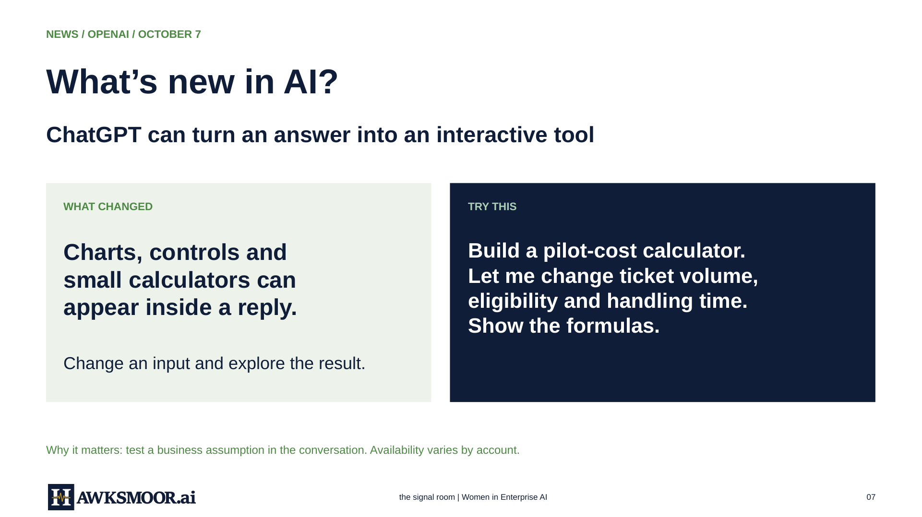
the Signal Room for Women in Enterprise AI
07
Notes:
the signal room | Women in Enterprise AI
07
the signal room | Women in Enterprise AI
07
NEWS / OPENAI / OCTOBER 7
What’s new in AI?
ChatGPT can turn an answer into an interactive tool
WHAT CHANGED
Charts, controls and
small calculators can
appear inside a reply.
Change an input and explore the result.
TRY THIS
Build a pilot-cost calculator.
Let me change ticket volume,
eligibility and handling time.
Show the formulas.
Why it matters: test a business assumption in the conversation. Availability varies by account.

Slide 8

NEWS / CHATGPT DOTS / LARA’S EXPERIENCE
What’s new in AI?
Falcon brings my Chief of Staff into daily work
FALCON / ONGOING EXECUTION
I give Falcon work to keep moving between conversations.
Draft materials. Surface follow-ups. Bring work back for review.
Falcon
HOBSON / CHIEF OF STAFF ROLE
My dot
My operating system sets priorities and keeps the commitment record.
Both need the same decisions, clear ownership and evidence of completion.
Blue-heart illustration
The overlap is useful. Shared records and confirmed handoffs keep the work coordinated.
the signal room | Women in Enterprise AI
the Signal Room for Women in Enterprise AI
08
Notes:
Lara describes Falcon as life-changing and says she feels much more organized after two weeks of frequent use. This is her experience, not a measured productivity claim. Chief of Staff names a role and operating discipline. Falcon is the dot she uses to carry ongoing work. Hobson is her separate Chief of Staff coordination role. This proposed division does not imply automatic synchronization or complete cross-project visibility. Keep one authoritative commitment record and confirm receipt of handoffs. The heart is a stylized illustration, not a captured Falcon avatar. Source: Lara’s October 14 request and October 12 operational handoff, summarized without private details. Product context: https://learn.chatgpt.com/docs/dots, accessed October 14, 2026.

Slide 9
NEWS / CHATGPT DOTS / EXAMPLES AND BENEFITS
What’s new in AI?
Two weeks with Falcon: less work to remember
HOW I’M USING FALCON
OPENAI’S SUGGESTED USE CASES
Preparing my sales deck and one-pager
Keep a proposal current as terms change
Developing a Chief of Staff workshop
Keep launch materials aligned
Moving guide and website work forward
Track event decisions and deadlines
“It’s been life-changing. I’m so much more organized.”
My experience. Assigned work still needs review. Access depends on plan, rollout and workspace settings.
the signal room | Women in Enterprise AI
the Signal Room for Women in Enterprise AI
09
Notes:
The left column lists work Lara reports assigning to Falcon: presentation and one-pager work, workshop development, and guide/website implementation. Assignment does not prove delivery. The quote is a concise rendering of Lara’s October 14 experience, with no hours-saved claim. The right column summarizes examples from OpenAI’s Meet dots documentation: proposal maintenance, launch alignment, and offsite planning. These are vendor-described uses, not independent tests. Benefit: continuity can reduce the effort of restarting tasks and remembering follow-ups. Give each responsibility sources, approval boundaries and a completion check. Review work before sharing it. Availability varies. Sources: Lara’s October 14 request and prior assignments; https://learn.chatgpt.com/docs/dots, accessed October 14, 2026. No client names, private operating records or personal details are included.

Slide 10
NEWS / DELOITTE / OCTOBER 12, 2026
What’s new in AI?
Unapproved AI use is also a leadership issue
SURVEYED AI-USING WORKERS
SENIOR LEADERS VERSUS STAFF
49%
32%
reported using unapproved tools
higher likelihood of unapproved use
Source: Deloitte Trust ID study, May 2026. Deloitte Insights article, October 12, 2026.
Make approved experimentation easier. Define permitted data and actions.
the Signal Room for Women in Enterprise AI
10
Notes:
Source: https://www.deloitte.com/global/en/insights/topics/emerging-technologies/personal-ai-agents-at-work.html. Published October 12, 2026; cites a May 2026 Deloitte Trust ID study. The denominator is workers already using AI at work. The 32% comparison is relative likelihood, not percentage points. These survey findings do not establish prevalence in this community.

Slide 11
NEWS / CONNECTED AGENTS
What’s new in AI?
Connected agents make trust a practical question
THE CONTEXT
WHAT TO DO
An agent can use tools
and work across steps.
Give it one
bounded job.
Its access and permissions matter.
Set allowed actions and a review step.
Keep human authority clear before connecting enterprise data.
the Signal Room for Women in Enterprise AI
11
Notes:
Connected agents require bounded permissions and accountable human ownership. Traditional controls need deliberate adaptation for non-human identities and delegated actions. No claim is made that agents are inherently unidentifiable. Reference: OpenAI Meet dots, https://learn.chatgpt.com/docs/dots, accessed October 15, 2026.

Slide 12
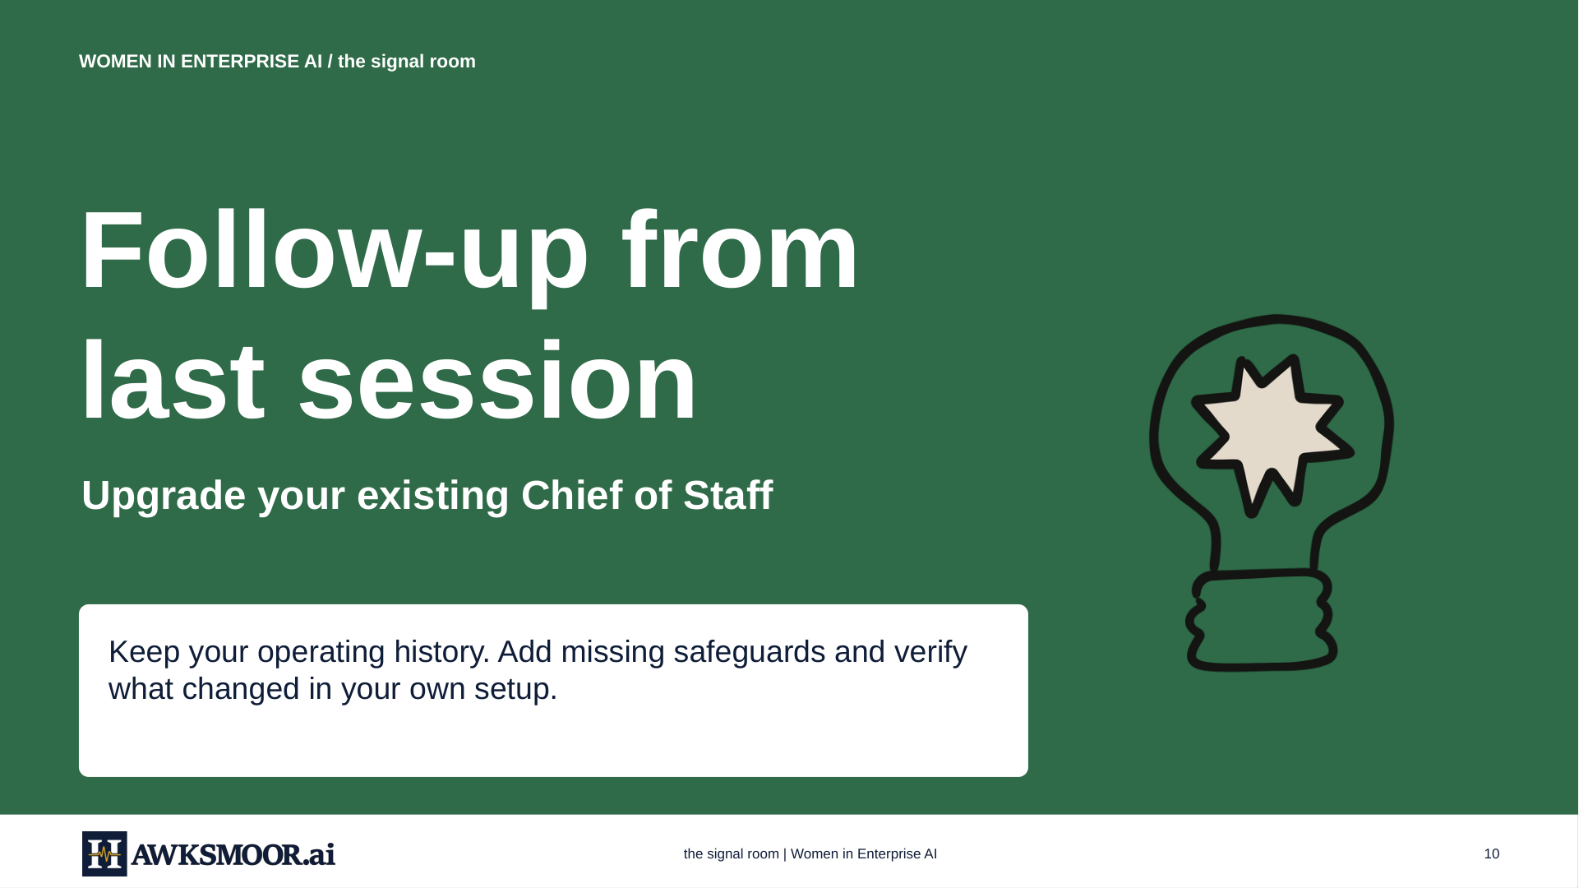
the Signal Room for Women in Enterprise AI
12
Notes:
the signal room | Women in Enterprise AI
10
the signal room | Women in Enterprise AI
10
WOMEN IN ENTERPRISE AI / the signal room
Follow-up from
last session
Upgrade your existing Chief of Staff
Keep your operating history. Add missing safeguards and verify
what changed in your own setup.

Slide 13
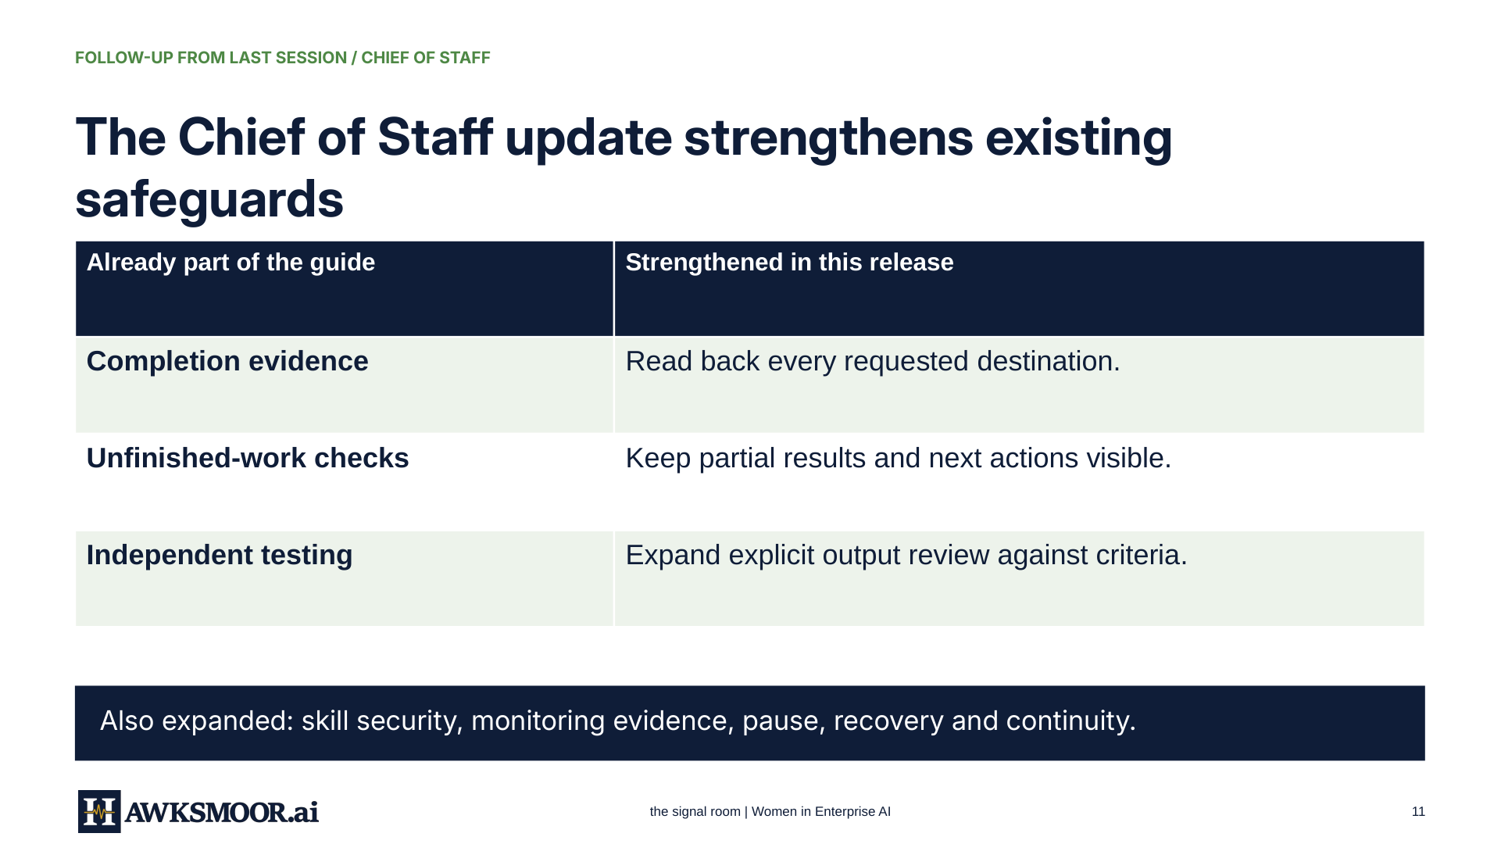
the Signal Room for Women in Enterprise AI
13
Notes:
the signal room | Women in Enterprise AI
11
the signal room | Women in Enterprise AI
11
FOLLOW-UP FROM LAST SESSION / CHIEF OF STAFF
The Chief of Staff update strengthens existing
safeguards
Already part of the guide
Strengthened in this release
Completion evidence
Read back every requested destination.
Unfinished-work checks
Keep partial results and next actions visible.
Independent testing
Expand explicit output review against criteria.
Also expanded: skill security, monitoring evidence, pause, recovery and continuity.

Slide 14
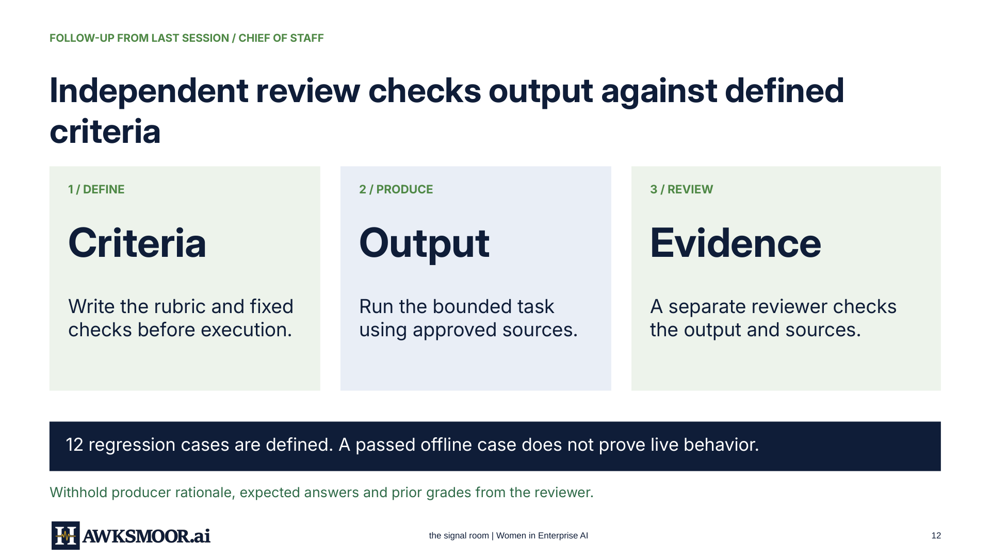
the Signal Room for Women in Enterprise AI
14
Notes:
the signal room | Women in Enterprise AI
12
the signal room | Women in Enterprise AI
12
FOLLOW-UP FROM LAST SESSION / CHIEF OF STAFF
Independent review checks output against defined
criteria
1 / DEFINE
Criteria
Write the rubric and fixed
checks before execution.
2 / PRODUCE
Output
Run the bounded task
using approved sources.
3 / REVIEW
Evidence
A separate reviewer checks
the output and sources.
12 regression cases are defined. A passed offline case does not prove live behavior.
Withhold producer rationale, expected answers and prior grades from the reviewer.

Slide 15
FOLLOW-UP FROM LAST SESSION / CHIEF OF STAFF
The upgrade preserves your operating history
KEEP
1 Attach the October 14 guide
Your charter
Canonical records
Task IDs
Original deadlines
Permissions
2 Compare and merge missing safeguards
3 Reopen and verify the records
Ask for a change log. Preserve stronger rules and your existing backlog.
the Signal Room for Women in Enterprise AI
15
Notes:
Use the October 14, 2026 guide, 42 pages. Ask your existing assistant to compare it with current instructions and apply only missing safeguards. Preserve the charter, source records, task identifiers, original deadlines, permissions and stronger existing rules. Verify the resulting records before declaring migration complete. No restart or duplicate backlog is required.

Slide 16
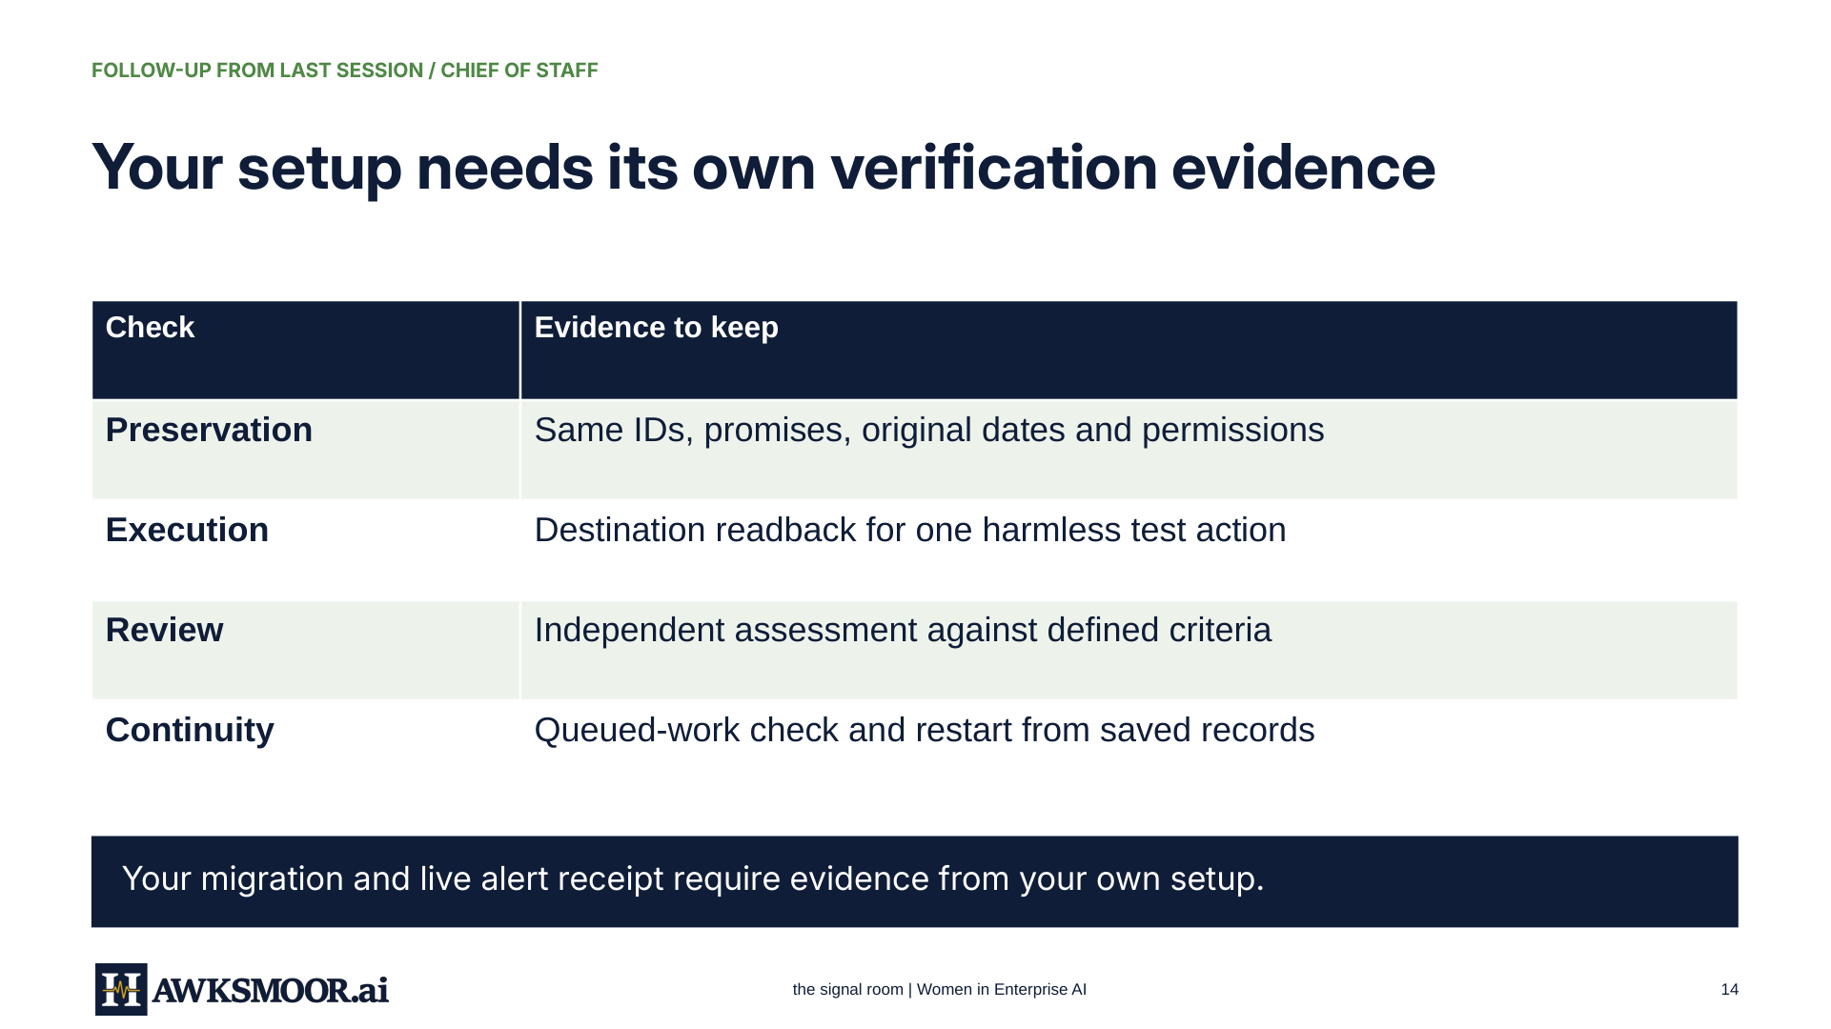
the Signal Room for Women in Enterprise AI
16
Notes:
the signal room | Women in Enterprise AI
14
the signal room | Women in Enterprise AI
14
FOLLOW-UP FROM LAST SESSION / CHIEF OF STAFF
Your setup needs its own verification evidence
Check
Evidence to keep
Preservation
Same IDs, promises, original dates and permissions
Execution
Destination readback for one harmless test action
Review
Independent assessment against defined criteria
Continuity
Queued-work check and restart from saved records
Your migration and live alert receipt require evidence from your own setup.

Slide 17
FOLLOW-UP FROM LAST SESSION / CHIEF OF STAFF SKILLS
Choose skills for work you need help with
A skill is reusable guidance for a recurring task.
Daily priorities
New-work triage, daily brief and weekly review
Reliable commitments
Task ledger, deadline risks and customer projects
Email and meetings
Inbox review, meeting preparation and follow-up
Operating foundations
Scope, permissions and operating handoffs
Decisions and alerts
Evidence-based briefs and notification audits
Optional work and life
Personal coordination and specialist workflows
18 skills: 14 core + 4 optional. Choose only what fits your work.
the Signal Room for Women in Enterprise AI
17
Notes:
Public starter kit version 1.3, October 14, 2026: 18 skills, consisting of 14 core and four optional skills. Source: public VERSION-NOTES.md and skill folder, checked October 15. Compare existing guidance before adding a skill. Security references and evaluation requirements are included; installation and live behavior still require testing. https://drive.google.com/drive/folders/1TAQfSrs6GphjCNPJ1h1KP3dw3qXA9wAC

Slide 18
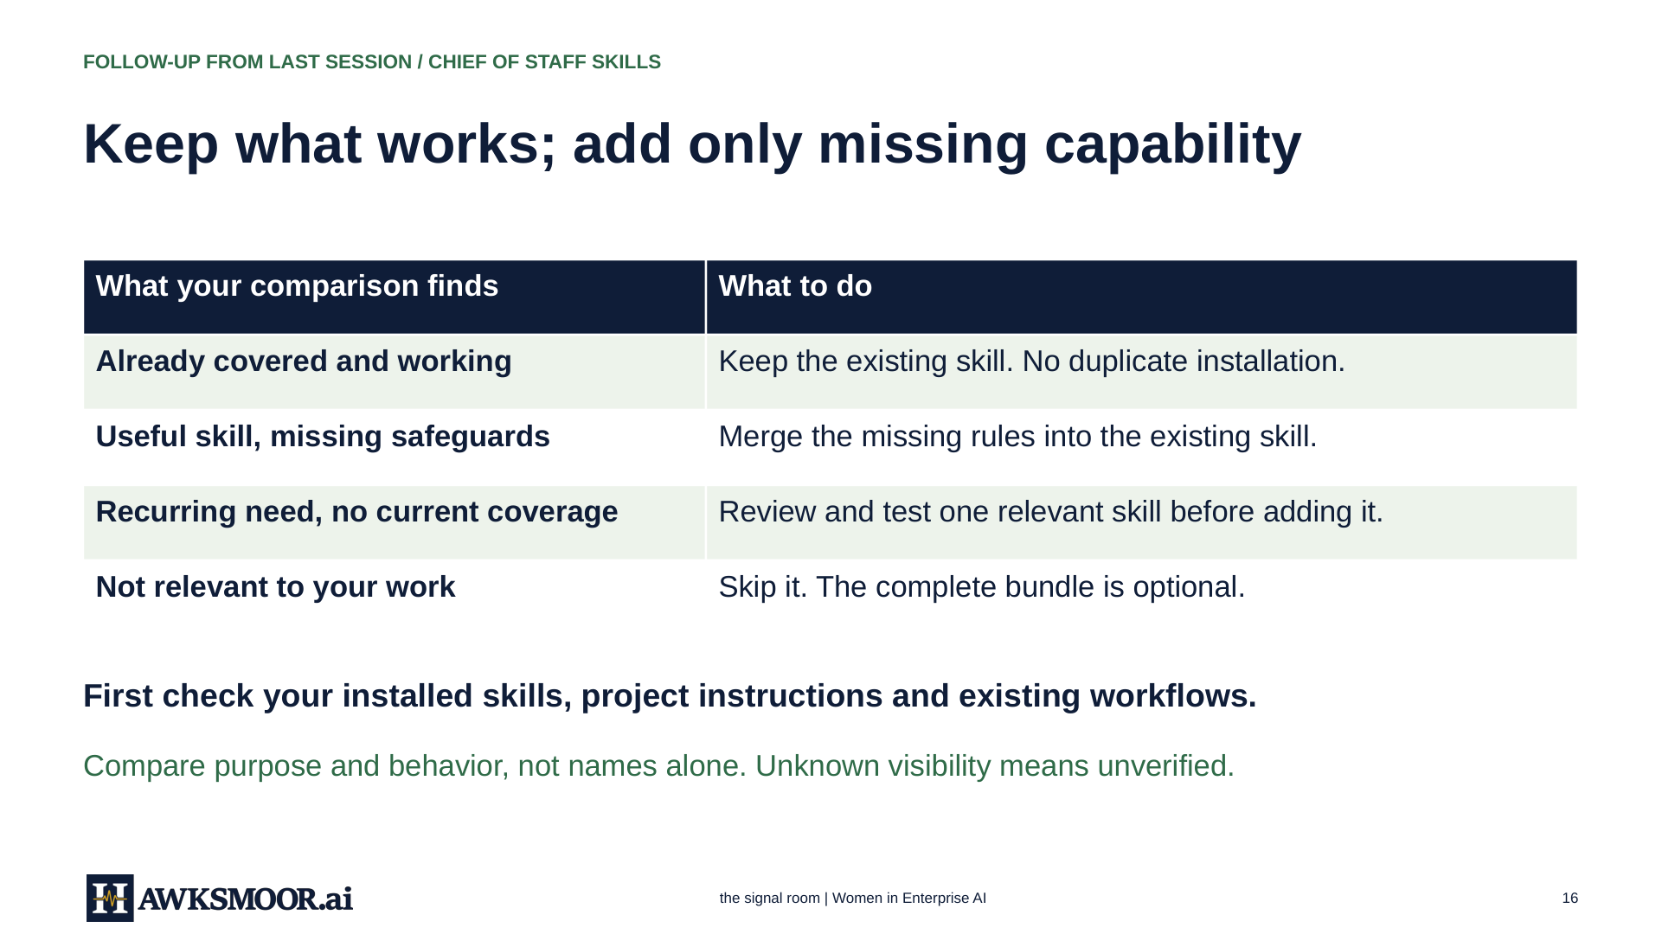
the Signal Room for Women in Enterprise AI
18
Notes:
the signal room | Women in Enterprise AI
16
the signal room | Women in Enterprise AI
16
FOLLOW-UP FROM LAST SESSION / CHIEF OF STAFF SKILLS
Keep what works; add only missing capability
What your comparison finds
What to do
Already covered and working
Keep the existing skill. No duplicate installation.
Useful skill, missing safeguards
Merge the missing rules into the existing skill.
Recurring need, no current coverage
Review and test one relevant skill before adding it.
Not relevant to your work
Skip it. The complete bundle is optional.
First check your installed skills, project instructions and existing workflows.
Compare purpose and behavior, not names alone. Unknown visibility means unverified.

Slide 19

TRY THIS / WORKING CALCULATORS
Try this: build a
calculator inside
ChatGPT.
ChatGPT can now build small working calculators with controls right inside a reply.
the Signal Room for Women in Enterprise AI
19
Notes:
Visualizations can place interactive calculators inside supported ChatGPT conversations. Availability depends on account and workspace. If needed, type @Visualize and choose the plugin before entering the prompt. Source: https://learn.chatgpt.com/docs/visualizations, accessed October 15, 2026. These examples use illustrative inputs.

Slide 20
CALCULATOR / COPY THIS PROMPT
Start with the decision you need to model
Build a pilot-cost calculator.
Let me change ticket volume,
eligibility, and handling time.
Show the formulas.
If needed, select @Visualize. Inspect the units and test one changed input.
the Signal Room for Women in Enterprise AI
20
Notes:
Copy the prompt shown. A dollar estimate requires a cost rate, so this example also includes an editable loaded hourly cost. Ticket volume covers the entire pilot period. The result is eligible workload labor cost, excluding implementation and software. It is not a full pilot budget or a claim of savings.

Slide 21
CALCULATOR EXAMPLE / 1
Pilot-cost calculator
Build a pilot-cost calculator. Let me change ticket volume, eligibility, and handling time. Show the formulas.
FORMULAS
Eligible tickets = volume × eligibility ÷ 100
Hours = eligible tickets × minutes ÷ 60
Labor cost = hours × hourly cost
SCREENSHOT:
Pilot-cost calculator
10,000 tickets · 40% eligible · 8 minutes · $50/hour
533.3 hours / $26,666.67 modeled labor cost
the Signal Room for Women in Enterprise AI
21
Notes:
Build a pilot-cost calculator. Let me change ticket volume, eligibility, and handling time. Show the formulas.
Eligible tickets = volume × eligibility ÷ 100
Hours = eligible tickets × minutes ÷ 60
Labor cost = hours × hourly cost
10,000 tickets · 40% eligible · 8 minutes · $50/hour
533.3 hours / $26,666.67 modeled labor cost
The working calculator is supplied in the conversation. The image area is a clearly marked screenshot placeholder. Inputs are illustrative. The pilot example estimates eligible workload labor cost. It excludes software and implementation costs.

Slide 22
CALCULATOR EXAMPLE / 2
AI time-saved calculator
Build an AI time-saved calculator. Inputs: people, weekly task hours per person, AI-handled percentage, and loaded hourly cost. Show monthly hours and dollars saved, with formulas.
FORMULAS
Monthly hours = people × weekly hours × AI share ÷ 100 × (52 ÷ 12)
Monthly labor value = monthly hours × hourly cost
SCREENSHOT:
AI time-saved calculator
20 people · 5 hours/week · 40% AI share · $60/hour
173.3 hours / $10,400 monthly labor value
the Signal Room for Women in Enterprise AI
22
Notes:
Build an AI time-saved calculator. Inputs: people, weekly task hours per person, AI-handled percentage, and loaded hourly cost. Show monthly hours and dollars saved, with formulas.
Monthly hours = people × weekly hours × AI share ÷ 100 × (52 ÷ 12)
Monthly labor value = monthly hours × hourly cost
20 people · 5 hours/week · 40% AI share · $60/hour
173.3 hours / $10,400 monthly labor value
The working calculator is supplied in the conversation. The image area is a clearly marked screenshot placeholder. Inputs are illustrative. Gross capacity value excludes review time and tool costs. It is not guaranteed cash savings.

Slide 23
CALCULATOR EXAMPLE / 3
Phase-two proposal cost calculator
Build a phase-two proposal cost calculator. Inputs: workstreams, weeks per workstream, and blended weekly rate. Show total cost and formulas. Use placeholder numbers only.
FORMULAS
Workstream-weeks = workstreams × weeks per workstream
Total cost = workstream-weeks × blended weekly rate
SCREENSHOT:
Phase-two proposal cost calculator
3 workstreams · 4 weeks each · $2,500/workstream-week
$30,000 total. Placeholder numbers only.
the Signal Room for Women in Enterprise AI
23
Notes:
Build a phase-two proposal cost calculator. Inputs: workstreams, weeks per workstream, and blended weekly rate. Show total cost and formulas. Use placeholder numbers only.
Workstream-weeks = workstreams × weeks per workstream
Total cost = workstream-weeks × blended weekly rate
3 workstreams · 4 weeks each · $2,500/workstream-week
$30,000 total. Placeholder numbers only.
The working calculator is supplied in the conversation. The image area is a clearly marked screenshot placeholder. Inputs are illustrative. The blended weekly rate applies to each workstream-week. Parallel work affects elapsed duration, not this effort-based total.

Slide 24
CALCULATORS / PRACTICAL USE
Where I’m using this
Modeling options on my website.
Helping a customer review a proposal
for the next phase of a build.
Change the assumptions. Keep the formulas visible.
the Signal Room for Women in Enterprise AI
24
Notes:
The host reports using calculators to model website options and help a customer review a phase-two proposal. No customer identity or commercial pricing is disclosed. A calculator prototype still needs formula and input checks before publication. This slide does not establish that any specific website deployment has been independently verified.

Slide 25
READ MORE
Sources behind this week’s discussion
OpenAI
Visualizations and interactive calculators
Checked Oct 15, 2026
OpenAI
Meet dots
Checked Oct 15, 2026
Meta
Muse Wonder and Muse Wonder Full
Oct 12, 2026
Deloitte
Personalized AI agents at work
Oct 12, 2026
Hawksmoor
Chief of Staff guide and skills v1.3
Oct 14, 2026
the Signal Room for Women in Enterprise AI
25
Notes:
OpenAI Visualizations: https://learn.chatgpt.com/docs/visualizations. OpenAI Meet dots: https://learn.chatgpt.com/docs/dots. Deloitte: https://www.deloitte.com/global/en/insights/topics/emerging-technologies/personal-ai-agents-at-work.html. Chief of Staff guide: https://www.hawksmoor.ai/resources/signal-room/2026-10-02-build-your-ai-chief-of-staff.pdf. Public skills: https://drive.google.com/drive/folders/1TAQfSrs6GphjCNPJ1h1KP3dw3qXA9wAC. Accessed October 15, 2026. Model announcements remain vendor claims.

Slide 26
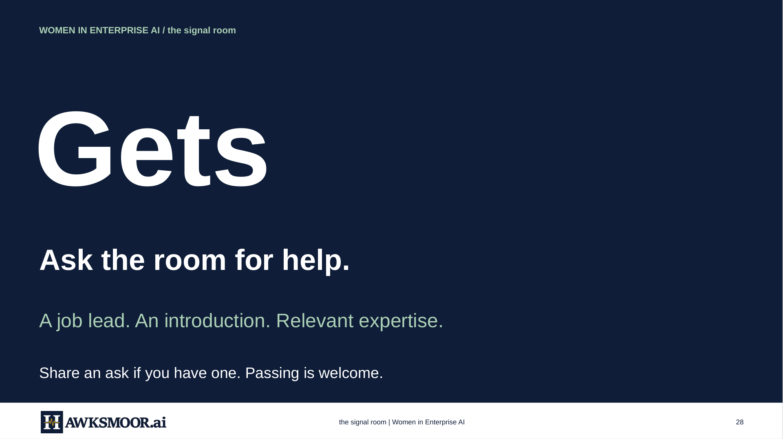
the Signal Room for Women in Enterprise AI
26
Notes:
the signal room | Women in Enterprise AI
28
the signal room | Women in Enterprise AI
28
WOMEN IN ENTERPRISE AI / the signal room
Gets
Ask the room for help.
A job lead. An introduction. Relevant expertise.
Share an ask if you have one. Passing is welcome.

Slide 27
WOMEN IN ENTERPRISE AI / WHAT’S NEXT
Future sessions
FRIDAY, OCTOBER 23 / 10 A.M. PT / 1 P.M. ET
Build a working calculator inside ChatGPT
Change assumptions and inspect the formulas.
FRIDAY, OCTOBER 30 / 10 A.M. PT / 1 P.M. ET
Amanda Machan, nCino
PLOPs Rewired and Workforce Acceleration
the Signal Room for Women in Enterprise AI
27
Notes:
October 23: calculator demonstration. October 30: Amanda Machan of nCino will discuss PLOPs Rewired, a hackathon, and Workforce Acceleration. Her October 14 email offered these topics and availability the week after October 23. The host explicitly authorized naming Amanda and nCino in the speaker announcement. Do not attribute this session’s private discussion to her.

Slide 28

the Signal Room for Women in Enterprise AI
28
Notes:
the signal room | Women in Enterprise AI
30
the signal room | Women in Enterprise AI
30
WOMEN IN ENTERPRISE AI
Thank
you.
Women in Enterprise AI
the signal room

